Slide 1
Copyright © 2009 MES-English.com

Slide 2
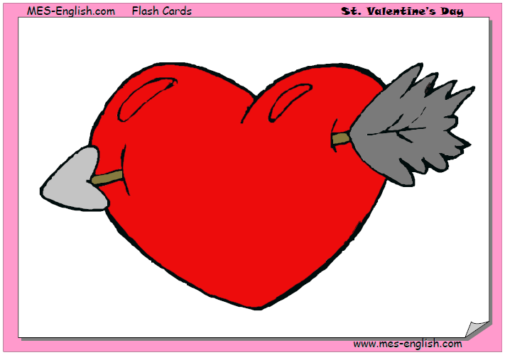
a heart

Slide 3

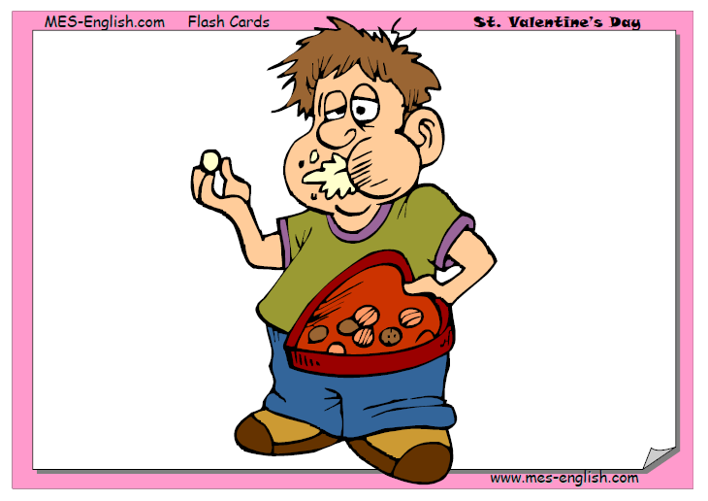
Valentine´s Card
a box of chocolates

Slide 4
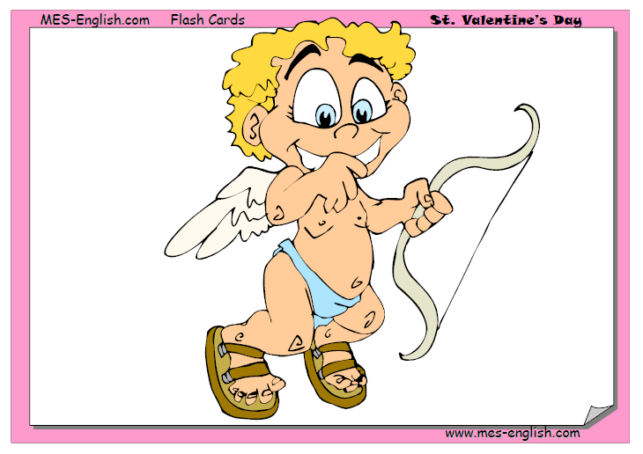
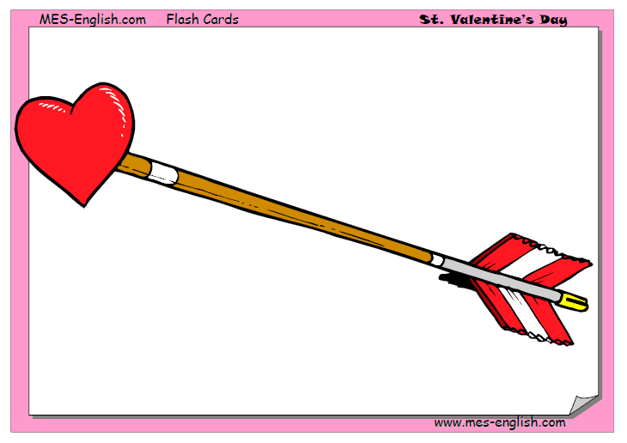
Cupid
an arrow

Slide 5
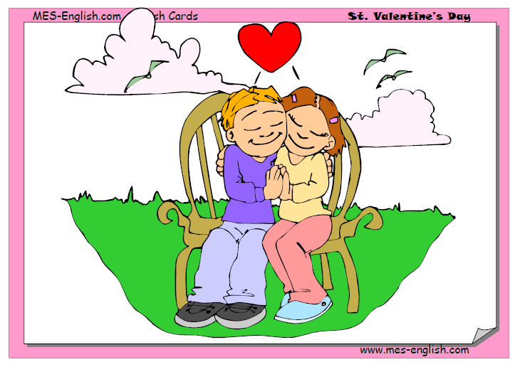
a date

Slide 6
a rose

Slide 7


Slide 8
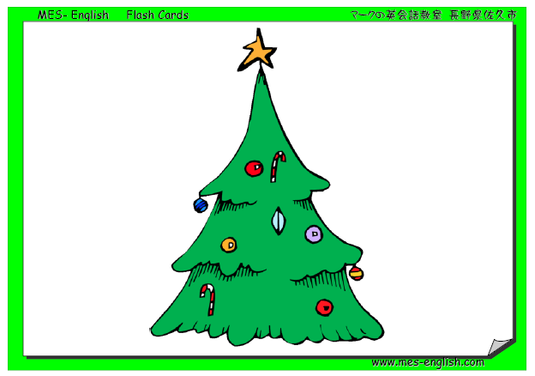
Christmas tree

Slide 9
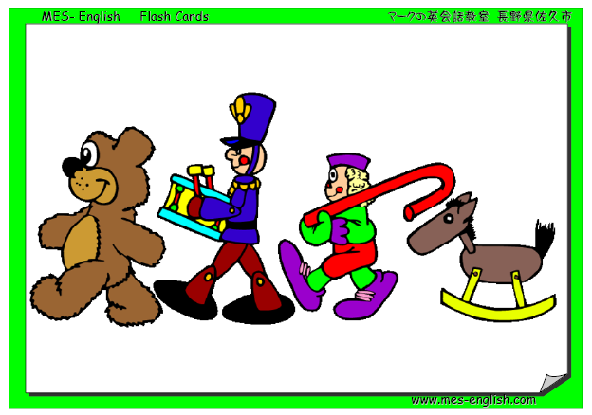
Christmas Presents / Gifts
Toys

Slide 10
Decorate the Tree

Slide 11
Nativity Scene

